Slide 1




Chongqing University of Technology
ATAI
Advanced Technique of Artificial Intelligence
Chongqing University of Technology
Edge-Labeling based Directed Gated Graph Network for Few-shot Learning（ICIP 2021）
Peixiao Zheng
Zhengzhou University
Xin Guo
Zhengzhou University
Lin Qi
Zhengzhou University
Reported by Ting Wang
Code: https://github.com/zpx16900/DGGN
2021.08.29

Slide 2

Chongqing University of Technology
ATAI
Advanced Technique of Artificial Intelligence
Chongqing University of Technology
1. Innovation
2. Method
3. Experiments
4. Conclusion

Slide 3
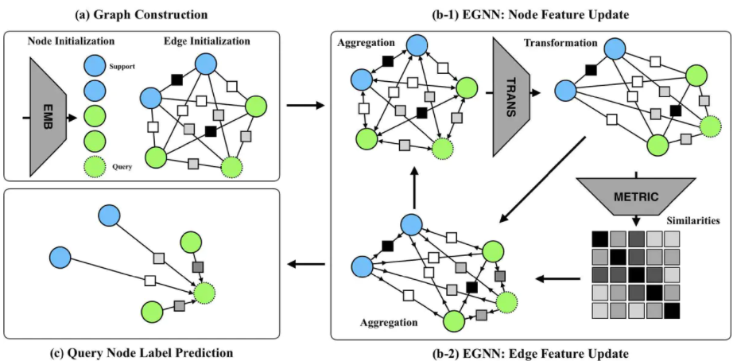
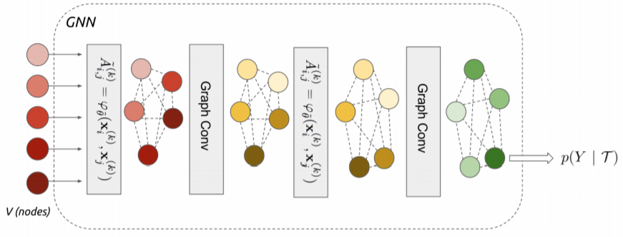
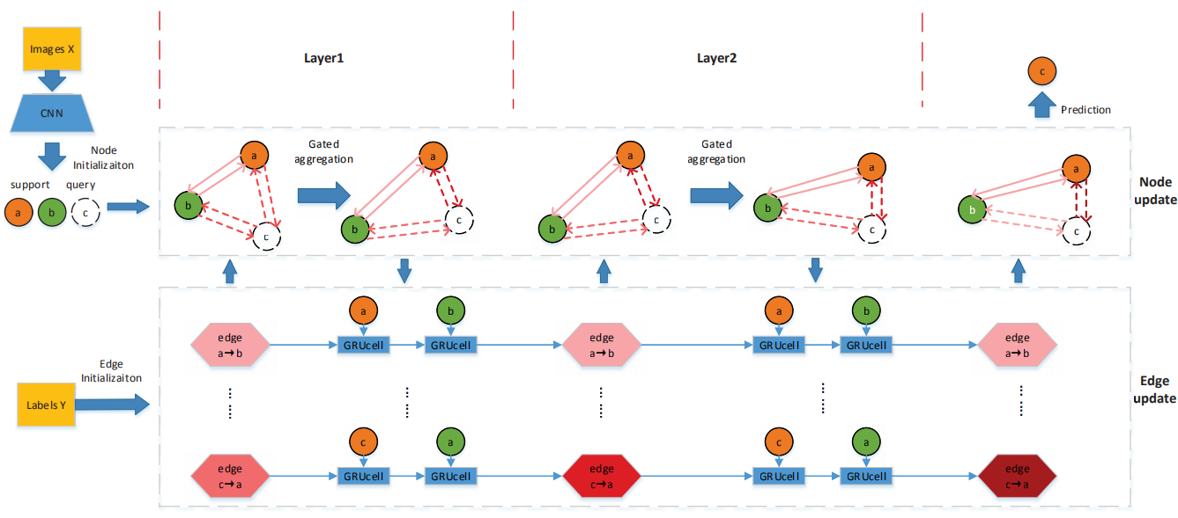
Background
1
2
FEW-SHOT LEARNING WITH GRAPH NEURAL NETWORKS(ICLR 2018)
Edge-Labeling Graph Neural Network for Few-shot Learning(CVPR 2019)
3
Edge-Labeling based Directed Gated Graph Neural Network for Few-shot Learning(ICIP 2021)

Slide 4
Innovation
1.The gated node update mechanism makes the node feature aggregation a learnable process, which can easily incorporate into an end-end framework.
2.The proposed improved GRU mechanism is appropriate for vector form node features compared with CNNs,and the GRU sequence throughout each layer is benefit for gradient backpropagation.
3.On few-shot image classification tasks, the proposed method providing improved numerical performance on two benchmark datasets.

Slide 5
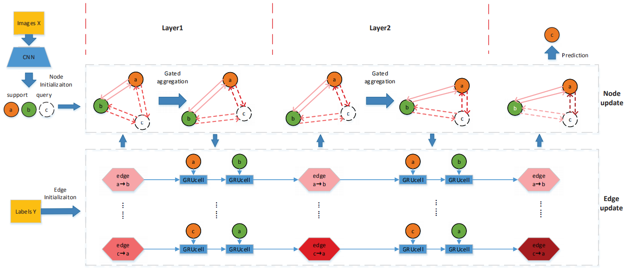
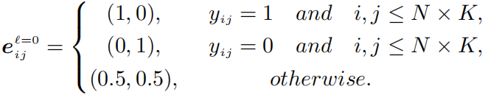



Approach
Edge label:
Edge feature:
(V:node E:edge T:number of all samples)
Node feature:

Slide 6

Approach
Gated node update mechanism:
(A, B, C are the weight parameters; σ is the sigmoid function)

Slide 7
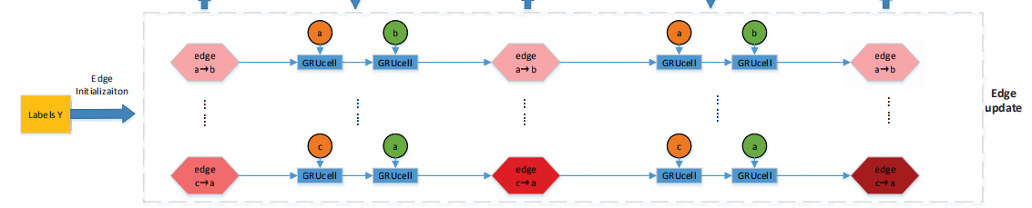






Approach
GRU based edge update mechanism:
(1)
(2)
GRU₁:
(3)
(4)
(5)
(6)
residual block:
(7)
(8)

Slide 8
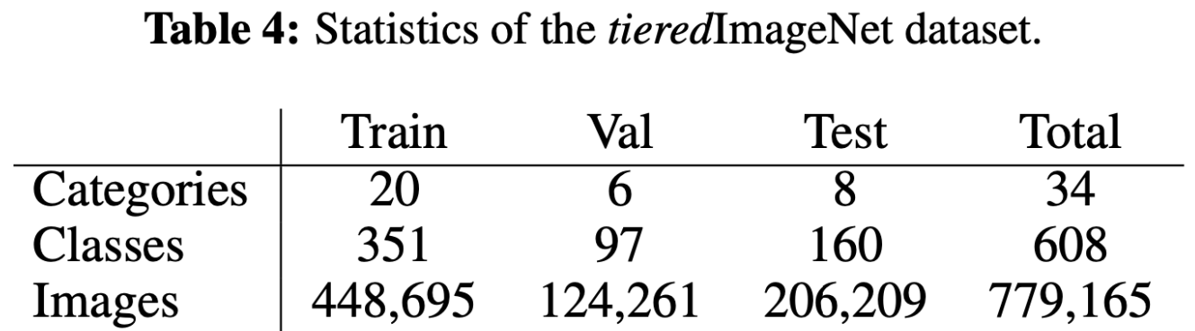
Experiments
miniImagenet: Contains a total of 60,000 images in 100 categories, with 600 samples in each category. Each image is 84*84 in size. Typically, the training set and test set categories of this data set are 80:20.
tieredImagenet:It is a subset of ILSVRC-12,there are 34 large categories, each containing between 10 and 30 classes. These are divided into 20 training, 6 validation and 8 test categories.

Slide 9
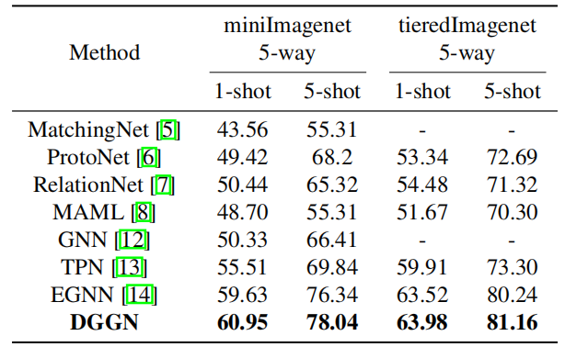
Experiments
Table 1: Few-shot classification performance on miniImagenet and tieredImagenet. Top results are highlighted.

Slide 10
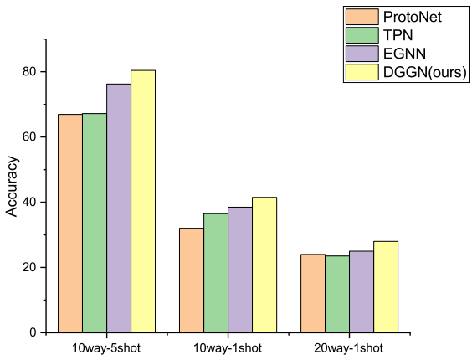
Experiments
Fig.2 High-way few-shot classification performance on
miniImagenet.

Slide 11
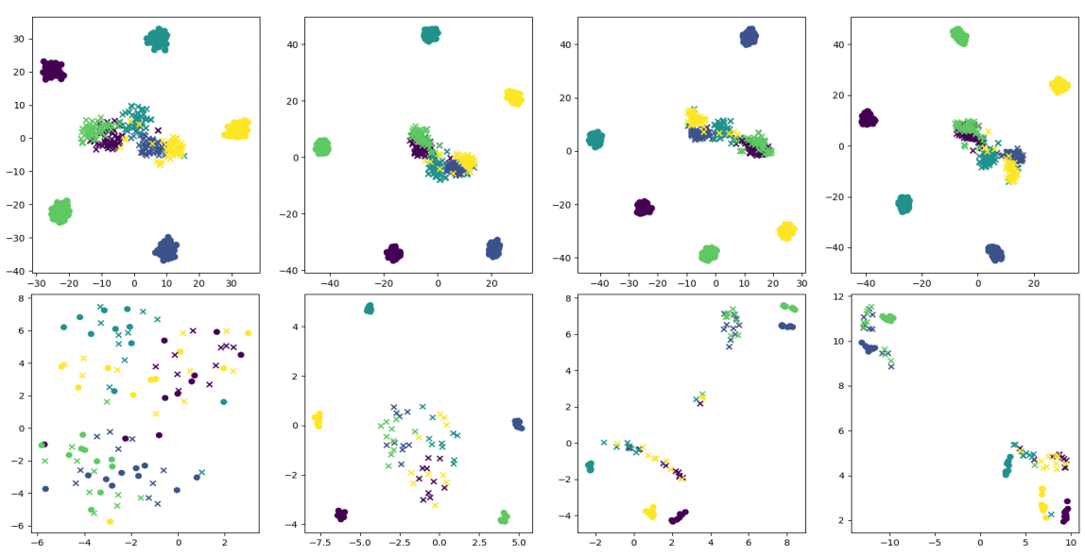
Experiments
initial embedding
layer 1
layer 2
layer 3
Fig.3 t-SNE visualization of node features.’x’ represents query, ’o’represents support. Different colors mean different labels.

Slide 12
Thanks!

